Slide 1
Articulated 3D SLAM
Matt Klingensmith

Slide 2
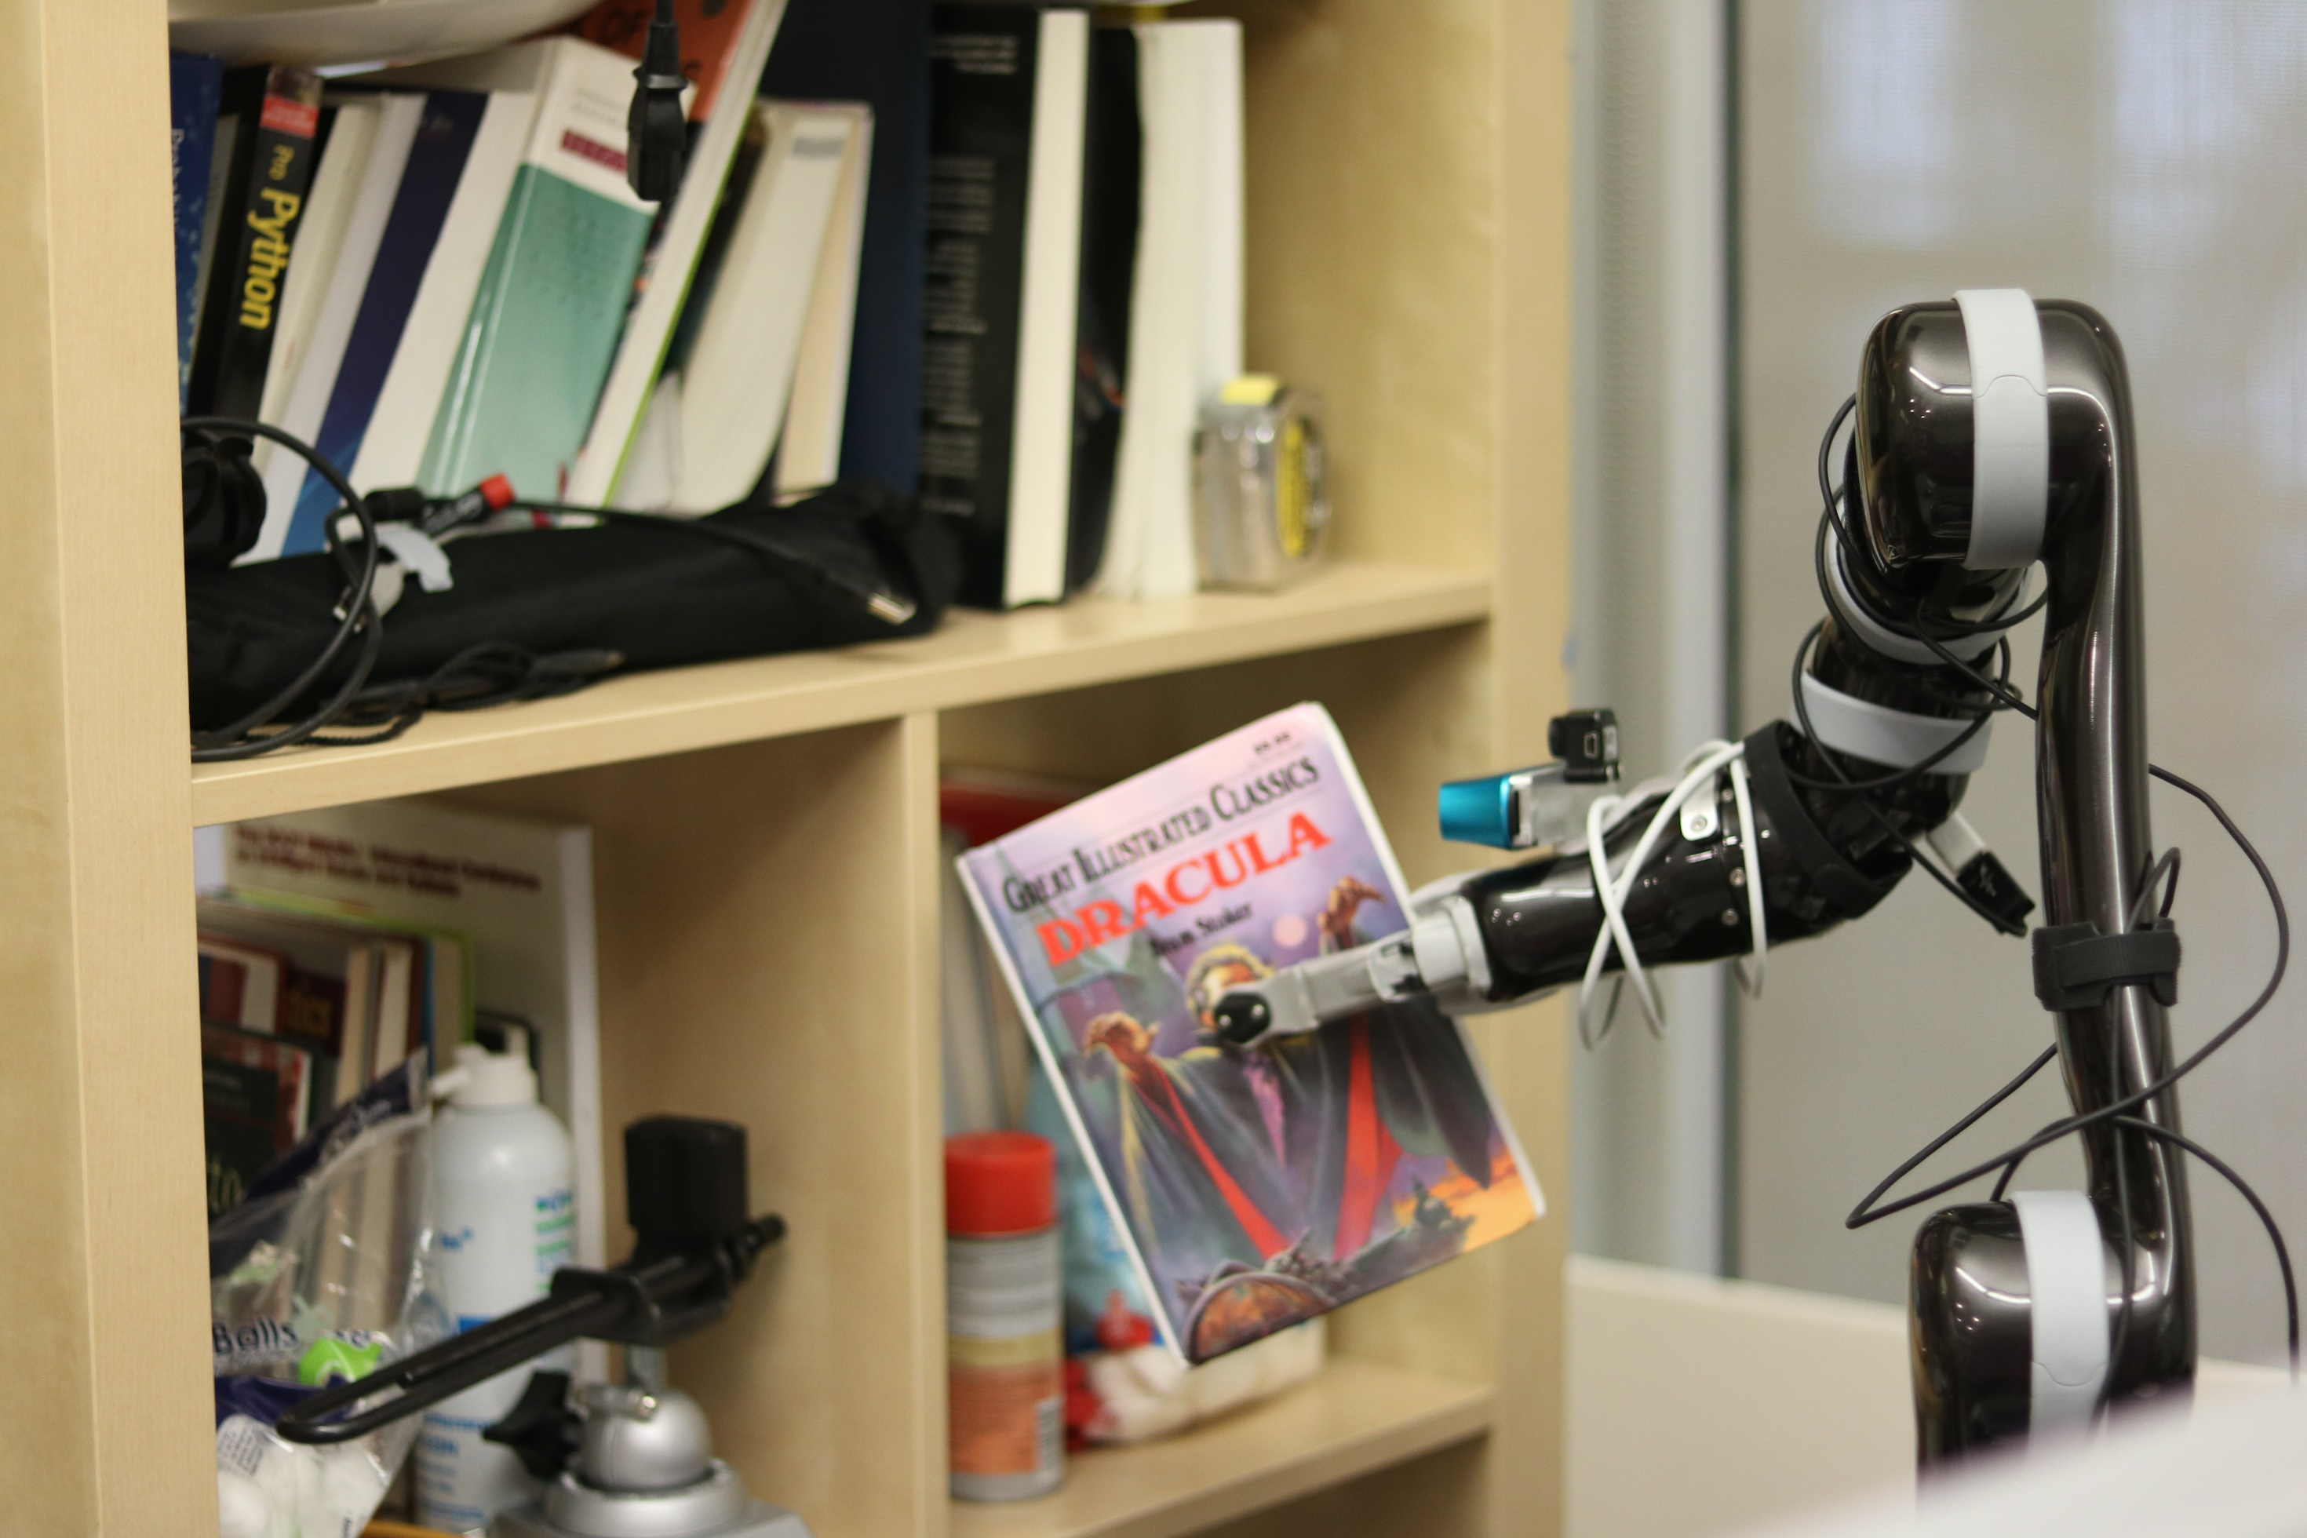

Slide 3
?

Slide 4
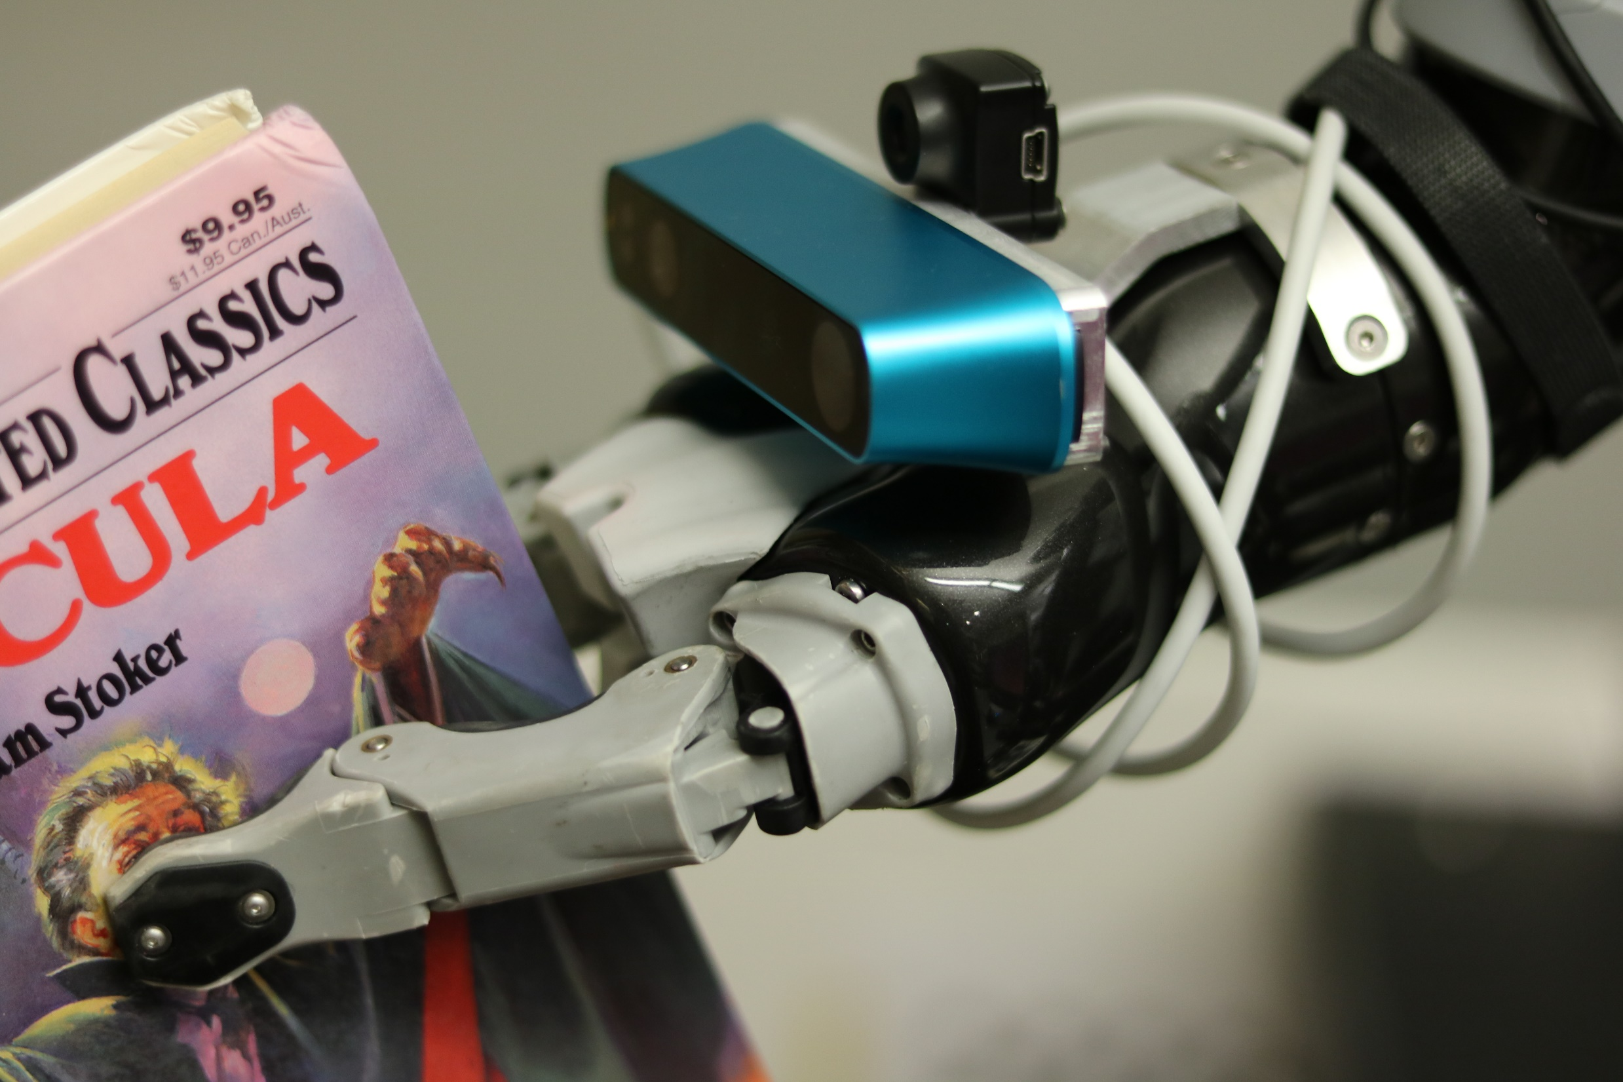

Slide 5
Color Camera
Depth Camera

Slide 7
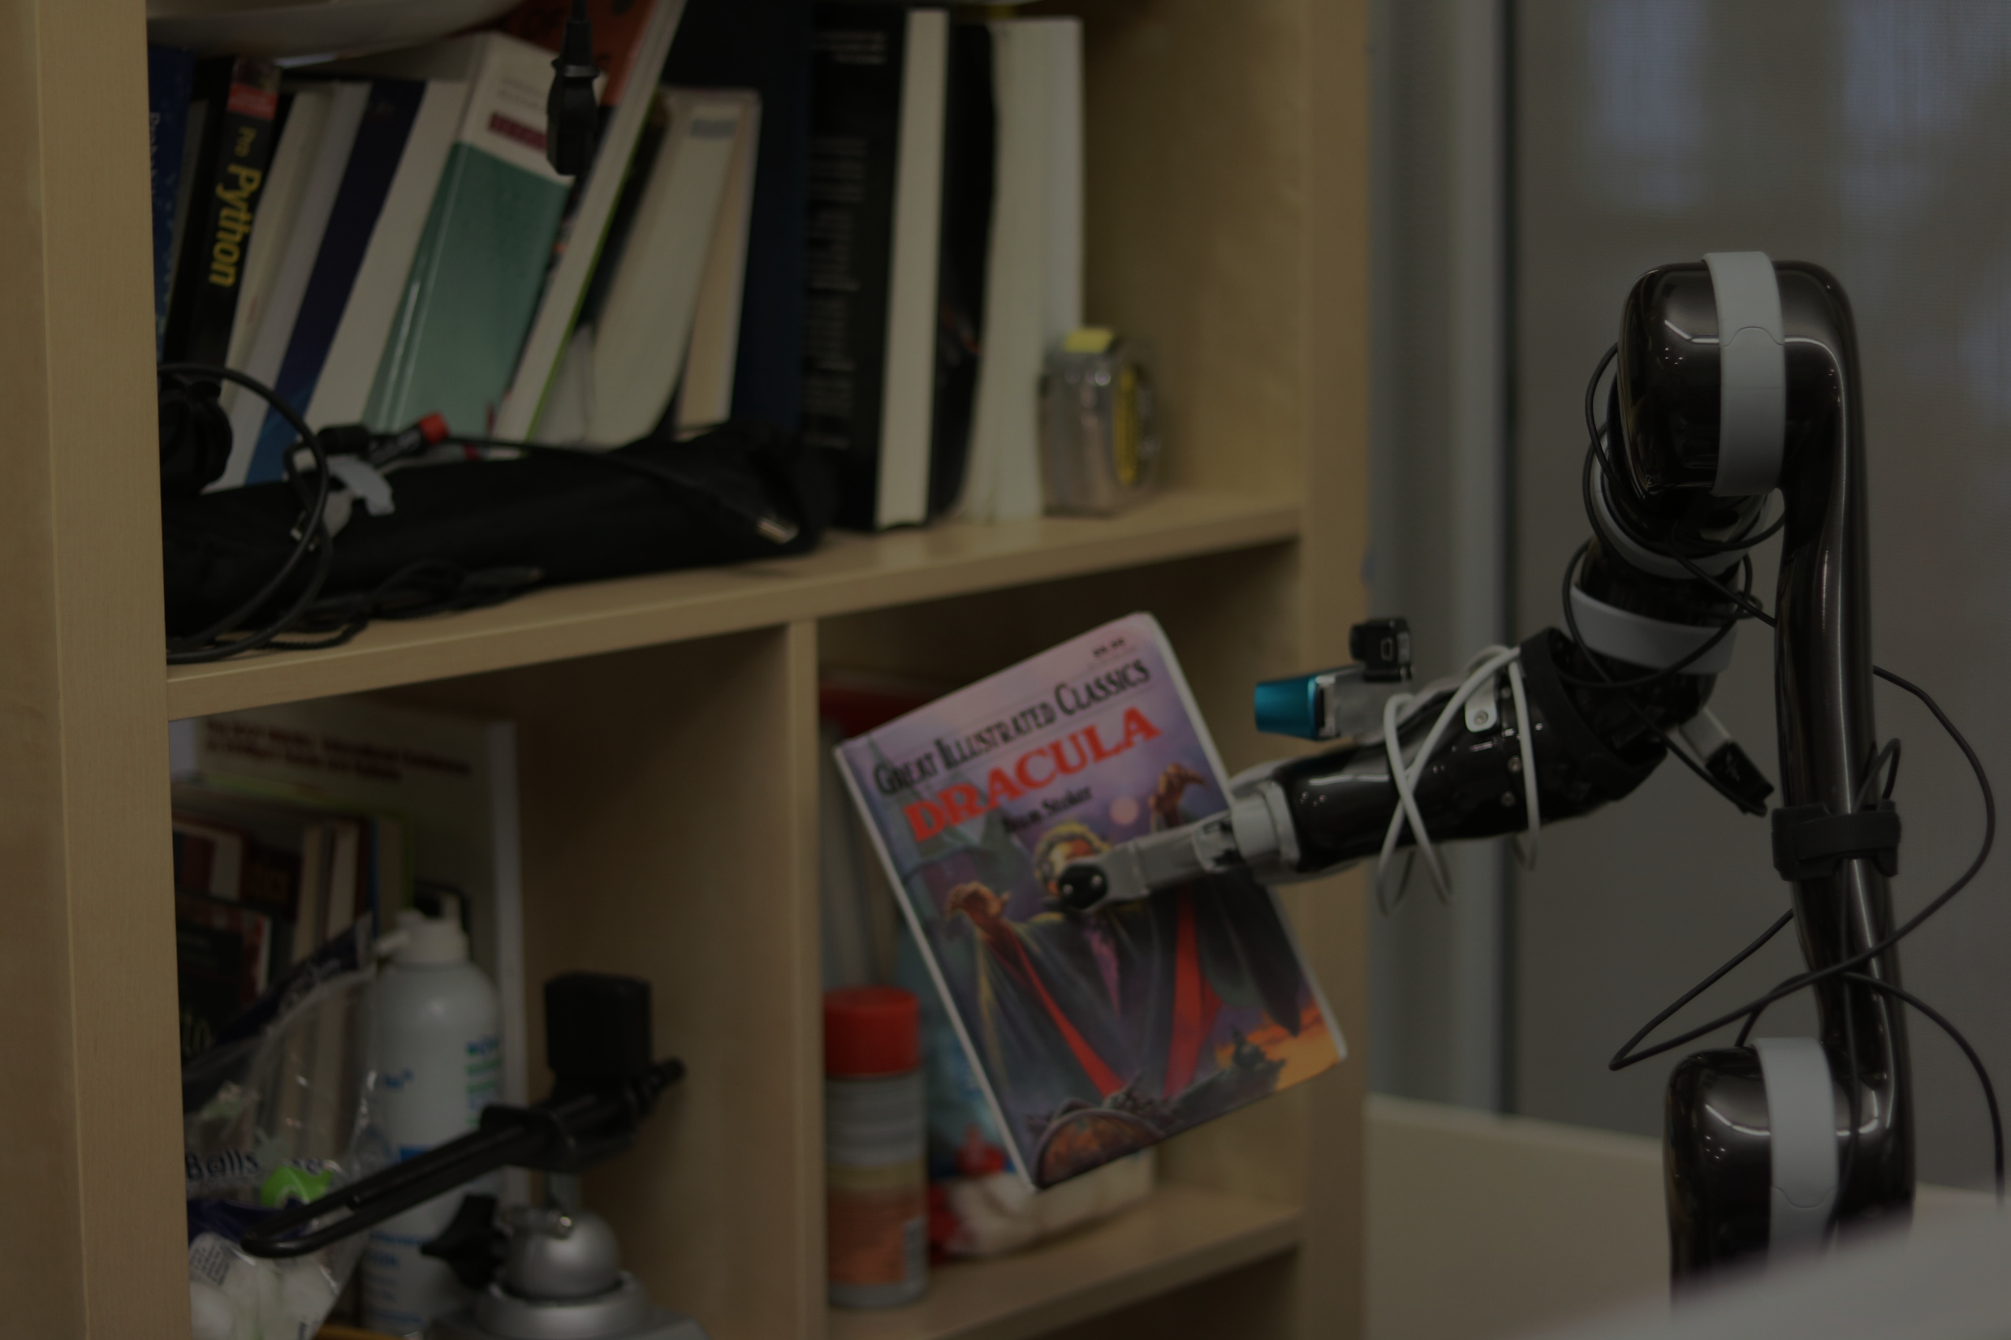

Slide 9
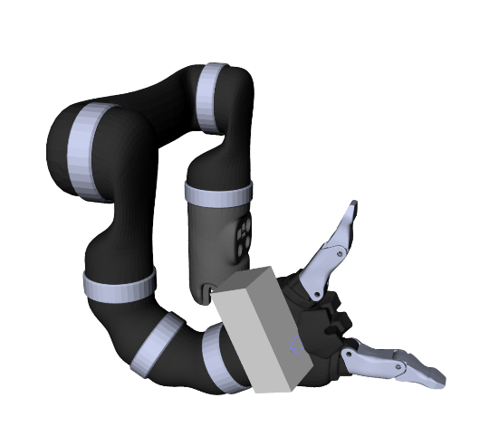

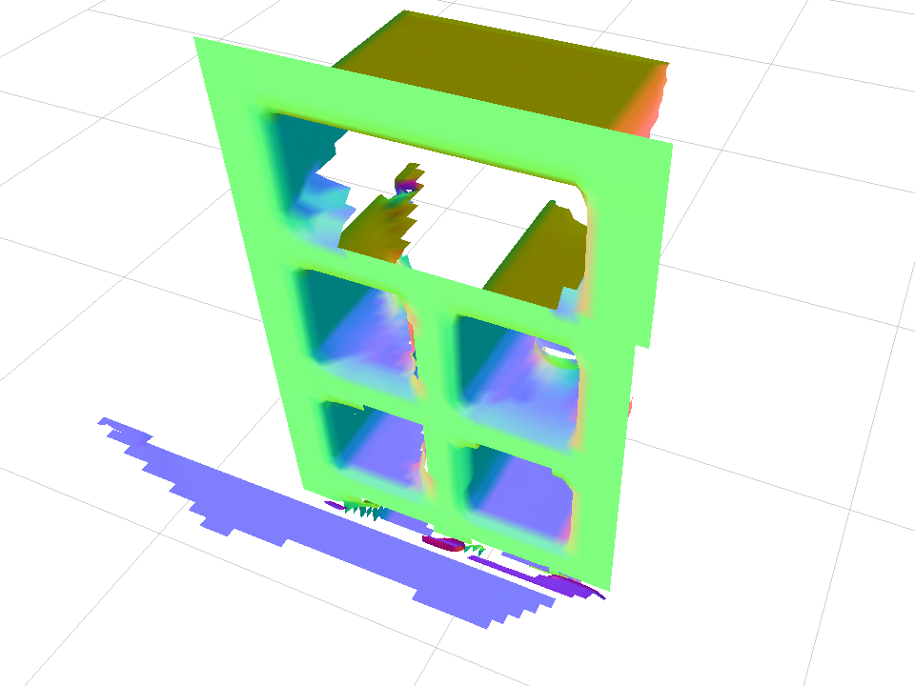
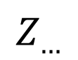
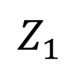
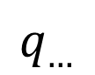
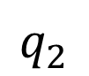
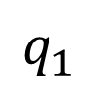
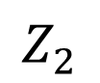
$$q_{1}$$
$$Z_{1}$$
M
$$q_{2}$$
$$Z_{2}$$
$$q_{…}$$
$$Z_{…}$$

Slide 10
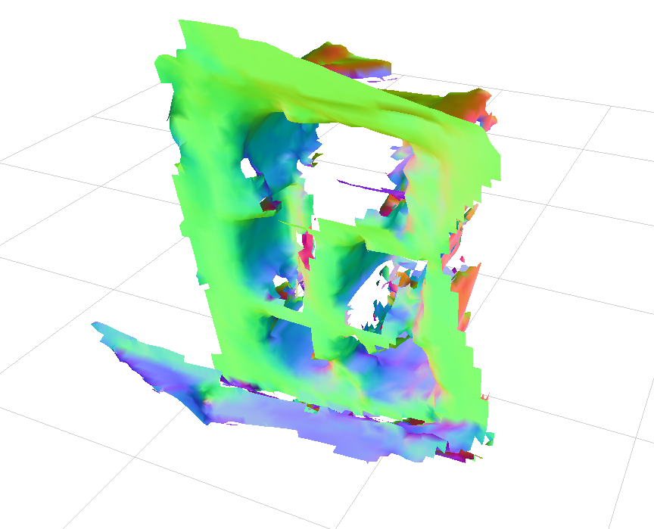

Slide 11


Two Main Error Sources
Sensor Uncertainty
Actuator Uncertainty

Slide 12
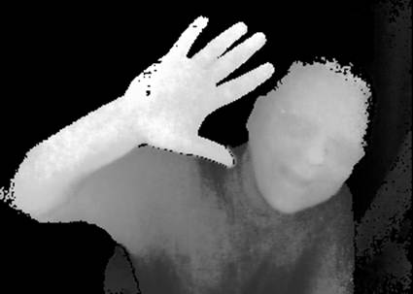
Sensor Uncertainty

Slide 13
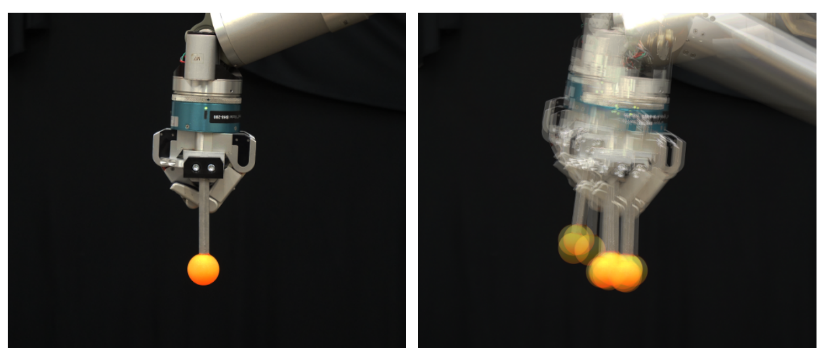
Actuator Uncertainty

Slide 14
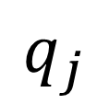
Actuator Uncertainty
Motor
Joint
$$q_{j}$$

Slide 15
Actuator Uncertainty
Mechanism
Motor
Joint
$$q_{j}$$

Slide 16
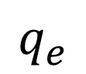
Actuator Uncertainty
Mechanism
Motor
Joint
$$q_{j}$$
Encoder
$$q_{e}$$

Slide 17
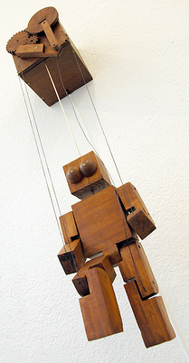
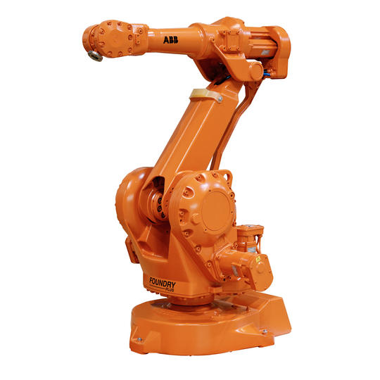
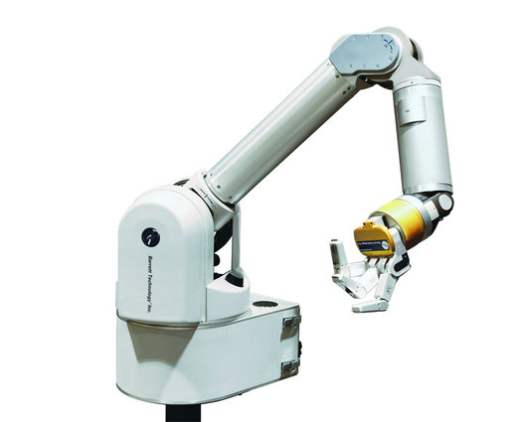
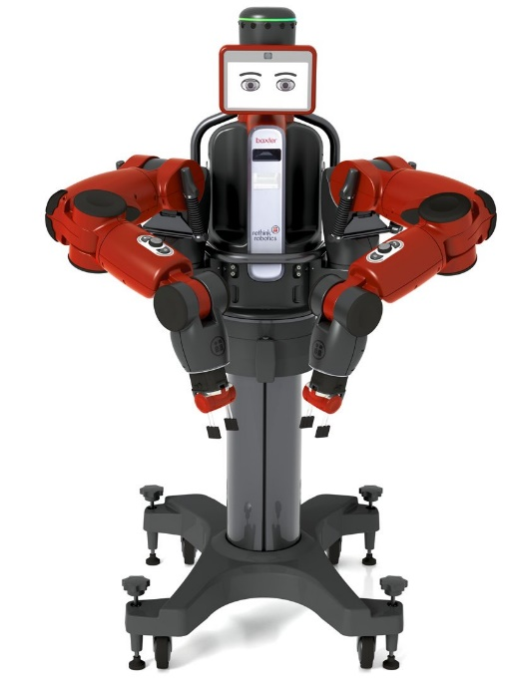
Actuator Uncertainty
More Direct
Less Direct

Slide 18
So when the pose is unknown… And the world is unknown…

Slide 19
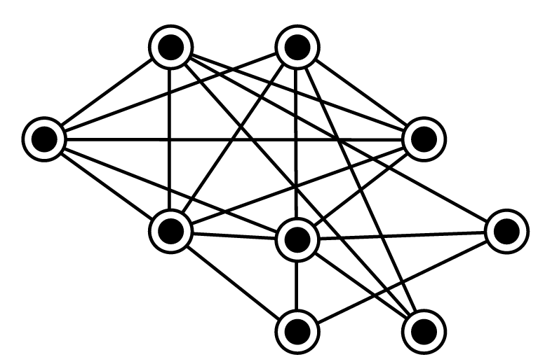
SLAM Problem

Slide 20
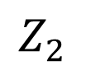
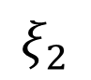
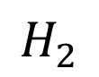
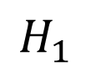
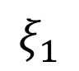
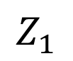

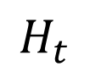
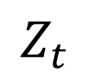
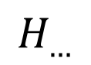
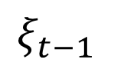
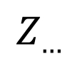
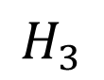
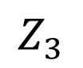
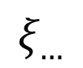
SLAM Background
$$M$$
$$Z_{1}$$
$$Z_{t}$$
$$Z_{2}$$
$$Z_{3}$$
$$Z_{…}$$
$$H_{1}$$
$$ξ_{1}$$
$$ξ_{2}$$
$$ξ_{…}$$
$$ξ_{t−1}$$
$$H_{2}$$
$$H_{3}$$
$$H_{…}$$
$$H_{t}$$

Slide 21

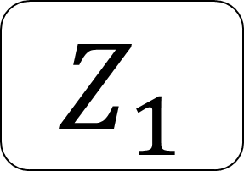



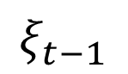
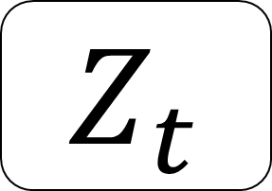
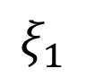

SLAM Background
$$M$$
$$Z_{1}$$
$$Z_{…}$$
$$Z_{t}$$
$$H_{1}$$
$$ξ_{1}$$
$$H_{…}$$
$$ξ_{t−1}$$
$$H_{t}$$

Slide 22
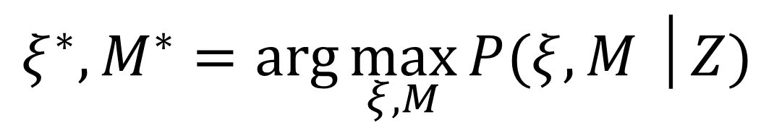
SLAM Background
$$ξ^{∗}, M^{∗}=\arg{\max_{ξ, M}{P(ξ, M │Z)}}$$
Trajectory, Map
Maximum Likelihood Estimate

Slide 23
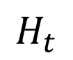
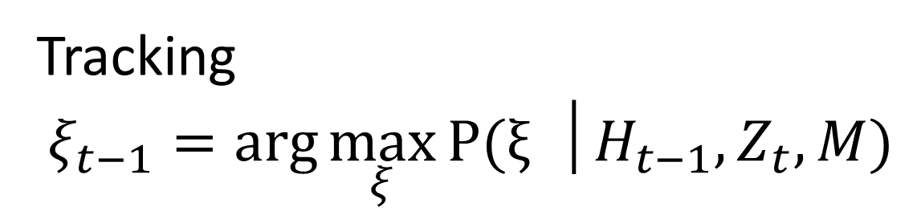
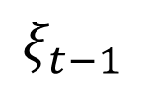
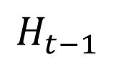
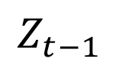

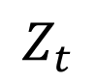
SLAM Background
Tracking
$$ξ_{t−1}=\arg{\max_{ξ}{\text{P}\text{(}ξ }}│H_{t−1}, Z_{t}, M)$$
$$ξ_{t−1}$$
$$H_{t}$$
$$H_{t−1}$$
$$Z_{t}$$
$$Z_{t−1}$$
$$M$$

Slide 24
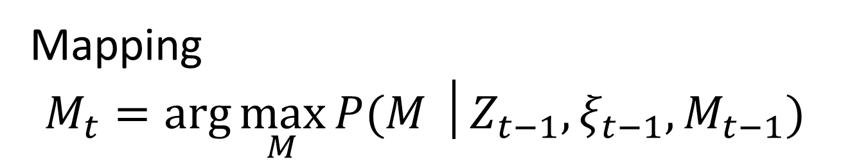
SLAM Background
Mapping
$$M_{t}=\arg{\max_{M}{P(M │Z_{t−1}, ξ_{t−1}, M_{t−1}) }}$$

